Slide 1
Introducing Astro: A next-generation framework for building lightning-fast, content-focused websites.
Nashtech .
20th Jun 2025

Slide 2
Introducing & Context
What is Astro?
The problem it solves
Core features & Innovations
Developer Experience
Use cases & Real-world examples
Demo
Q&A

Slide 3
01
Introducing & Context

Slide 4
Introducing & Context
First look in Astro
Astro is a modern web framework designed for building fast, content-driven websites such as blogs, marketing pages, and documentation sites.
Created with a focus on performance and simplicity.
Uses the principle of “Islands Architecture” — only hydrate interactive components when needed.
Supports multiple UI frameworks like React, Vue, Svelte, Solid, and more in the same project.
Notes:
Component là một đơn vị độc lập trong phần mềm, có thể được tái sử dụng và kết hợp với các component khác để xây dựng ứng dụng lớn hơn.

Slide 5
Introducing & Context
Why Astro?
Traditional JavaScript-heavy frameworks (e.g., React, Next.js) often send too much JavaScript to the browser → slower page loads.
Many modern websites are content-focused, not app-like — they don’t need complex interactivity everywhere.
Developers wanted a way to combine modern development tools with static-site speed.
Astro was created to solve this by shipping zero JavaScript by default — unless you explicitly add interactivity.
Notes:
Component là một đơn vị độc lập trong phần mềm, có thể được tái sử dụng và kết hợp với các component khác để xây dựng ứng dụng lớn hơn.

Slide 6
Introducing & Context
Key Goals of Astro
Performance-first: Load only what’s necessary.
Content-focused: Optimized for blogs, marketing, and documentation sites.
Flexible: Works with any UI framework or none at all.
Developer-friendly: Simple setup, modern syntax, Markdown & MDX support.
Future-ready: Built for edge deployment and static hosting.
Notes:
Component là một đơn vị độc lập trong phần mềm, có thể được tái sử dụng và kết hợp với các component khác để xây dựng ứng dụng lớn hơn.

Slide 7
02
What is Astro?

Slide 8
What is Astro?
What is Astro?
Astro is a modern, static-first web framework for building fast and content-focused websites.
It helps developers create pages that load quickly by sending less JavaScript to the browser.
Ideal for blogs, portfolios, marketing sites, and documentation.
Developed and maintained by the Astro Open Source Community.
Notes:
Component là một đơn vị độc lập trong phần mềm, có thể được tái sử dụng và kết hợp với các component khác để xây dựng ứng dụng lớn hơn.

Slide 9
What is Astro?
How astro delivers speed
Uses Islands Architecture:
→ Only loads JavaScript for interactive parts of a page.
Zero JavaScript by default — unless interactivity is required.
Generates static HTML during build time for each page.
Supports partial hydration: only hydrate dynamic components when necessary.
Notes:
Component là một đơn vị độc lập trong phần mềm, có thể được tái sử dụng và kết hợp với các component khác để xây dựng ứng dụng lớn hơn.

Slide 10
What is Astro?
Key Features That Make Astro Stand Out
Framework Agnostic: Works with React, Vue, Svelte, Solid, etc.
Markdown & MDX Support: Write content easily for blogs or docs.
Built-in Image Optimization: Compress and serve responsive images.
Server-Side Rendering (SSR) and Static Site Generation (SSG) options.
Fast by Design: Astro pages often score 100/100 on Lighthouse.
Notes:
Component là một đơn vị độc lập trong phần mềm, có thể được tái sử dụng và kết hợp với các component khác để xây dựng ứng dụng lớn hơn.

Slide 11
03
The problem it’s solve

Slide 12
The problem astro solve
Too Much JavaScript, Too Slow Websites
Many websites today use frameworks like React, Vue, or Angular.
These frameworks often send large JavaScript bundles to the browser.
Result:
Slow page loads ⏳
Poor performance on mobile devices 📱
Lower SEO ranking and user experience
Notes:
What It Is: Loop components are reusable pieces of content (e.g., tables, lists, notes, or task trackers) that can be embedded and synced across Microsoft 365 apps like Teams, Outlook, and Word.
Why It Matters: Instead of copying and pasting information, components stay updated in real time wherever they’re used. For example, a project task list in Loop will automatically update if edited in Teams or Outlook.
Example: "Create a task list in Loop, share it in a Teams chat, and watch it update in real time as team members make changes."

Slide 13
The problem astro solve
Content Websites Don’t Need Heavy Frameworks
Most websites — blogs, marketing pages, documentation — are content-focused, not web apps.
They show mostly static content (text, images, articles).
Using app-style frameworks adds unnecessary complexity and extra JavaScript.
Developers needed a tool focused on speed and simplicity for content.
Notes:
What It Is: Loop components are reusable pieces of content (e.g., tables, lists, notes, or task trackers) that can be embedded and synced across Microsoft 365 apps like Teams, Outlook, and Word.
Why It Matters: Instead of copying and pasting information, components stay updated in real time wherever they’re used. For example, a project task list in Loop will automatically update if edited in Teams or Outlook.
Example: "Create a task list in Loop, share it in a Teams chat, and watch it update in real time as team members make changes."

Slide 14
The problem astro solve
Astro’s Solution
Zero JavaScript by default: Only load JS when needed for interactivity.
Pre-renders pages to static HTML for ultra-fast load times.
Uses Islands Architecture — hydrate only interactive components.
Delivers faster, lighter, and SEO-friendly websites.
Lets developers combine different UI frameworks easily.
Notes:
What It Is: Loop components are reusable pieces of content (e.g., tables, lists, notes, or task trackers) that can be embedded and synced across Microsoft 365 apps like Teams, Outlook, and Word.
Why It Matters: Instead of copying and pasting information, components stay updated in real time wherever they’re used. For example, a project task list in Loop will automatically update if edited in Teams or Outlook.
Example: "Create a task list in Loop, share it in a Teams chat, and watch it update in real time as team members make changes."

Slide 15
04
Core features & Innovations

Slide 16
Core features & Innovations
Core Feature #1: Zero JavaScript by Default
Astro ships no JavaScript to the browser unless you explicitly add it.
Every page is pre-rendered to static HTML, so it loads instantly.
Users see content immediately — no waiting for scripts to run.
Ideal for blogs, marketing sites, and documentation.

Slide 17
Core features & Innovations
Core Feature #2: Islands Architecture
Astro uses Islands Architecture to handle interactive components.
Each “island” (e.g., a carousel, menu, or form) is hydrated independently.
This means:
Faster rendering
Better performance
Smaller JavaScript bundles
Supports partial hydration — only interactive parts get JS.

Slide 18
Core features & Innovations
Core Innovations
Multi-framework support: Use React, Vue, Svelte, Solid, or just HTML — in the same project.
Markdown & MDX integration: Perfect for content-rich sites.
Built-in image optimization: Automatically resizes and compresses images.
Flexible rendering: Choose between Static Site Generation (SSG) or Server-Side Rendering (SSR).
Modern developer experience: Fast builds, TypeScript ready, file-based routing.

Slide 19
05
Developer Experience

Slide 20
Developer Experience
Simplicity and Ease of Use
Astro’s syntax is clean and beginner-friendly — similar to HTML and Markdown.
Developers can start a project in minutes using npm create astro@latest.
File-based routing makes navigation structure easy to manage.
Minimal configuration — focus on building, not setup.
Notes:
What It Means: Loop enables real-time collaboration, allowing team members to work together more effectively, regardless of location.
Why It Matters: This reduces delays caused by waiting for feedback or updates and ensures everyone is aligned.
Example: "Instead of sending multiple versions of a document back and forth, we can all edit the same Loop component in real time."

Slide 21
Developer Experience
Modern Developer Tools
Hot Module Reloading (HMR): Instant preview while editing.
TypeScript & JSX support out of the box.
Markdown & MDX integration for content-driven projects.
Works seamlessly with VS Code, Git, and popular build tools.
Compatible with NPM packages and modern front-end libraries.
Notes:
What It Means: Loop enables real-time collaboration, allowing team members to work together more effectively, regardless of location.
Why It Matters: This reduces delays caused by waiting for feedback or updates and ensures everyone is aligned.
Example: "Instead of sending multiple versions of a document back and forth, we can all edit the same Loop component in real time."

Slide 22
Developer Experience
Flexibility and Extensibility
Use your favorite UI framework — React, Vue, Svelte, Solid, or plain HTML.
Add features easily through Astro Integrations (e.g., Tailwind, Sitemap, Image).
Deploy anywhere: Netlify, Vercel, Cloudflare, or your own server.
Developers get the best of static and dynamic worlds — choose SSG or SSR.
Excellent documentation and a friendly open-source community.
Notes:
What It Means: Loop enables real-time collaboration, allowing team members to work together more effectively, regardless of location.
Why It Matters: This reduces delays caused by waiting for feedback or updates and ensures everyone is aligned.
Example: "Instead of sending multiple versions of a document back and forth, we can all edit the same Loop component in real time."

Slide 23
06
Use cases & Real-world examples

Slide 24
Use cases & Real-world examples
Ideal Use Cases
Blogs & Portfolios → Fast loading, SEO-friendly, easy Markdown content.
Marketing & Landing Pages → Lightweight, highly optimized, easy to deploy.
Documentation Sites → Integrates Markdown/MDX, supports code highlighting.
News & Content Hubs → Handles large volumes of static content efficiently.
E-commerce Previews or Hybrid Sites → Combine static speed with dynamic parts.
Notes:
What It Means: Loop enables real-time collaboration, allowing team members to work together more effectively, regardless of location.
Why It Matters: This reduces delays caused by waiting for feedback or updates and ensures everyone is aligned.
Example: "Instead of sending multiple versions of a document back and forth, we can all edit the same Loop component in real time."

Slide 25
Use cases & Real-world examples
Real-World Examples
Google Chrome Developers Blog – migrated to Astro for faster page loads.
Skypack – uses Astro for a clean, fast documentation experience.
The Guardian Engineering Blog – built on Astro for static publishing.
Astro’s own documentation site – showcases best practices in content and performance.
Notes:
What It Means: Loop enables real-time collaboration, allowing team members to work together more effectively, regardless of location.
Why It Matters: This reduces delays caused by waiting for feedback or updates and ensures everyone is aligned.
Example: "Instead of sending multiple versions of a document back and forth, we can all edit the same Loop component in real time."

Slide 26
Use cases & Real-world examples
Results & Impact
Faster performance: Up to 90% smaller JS bundles and instant page loads.
Better SEO: Static HTML improves search engine visibility.
Lower hosting costs: Static files are easy to deploy on CDNs.
Improved user experience: Faster pages mean lower bounce rates.
Developer satisfaction: Simpler codebase, fewer dependencies, easier maintenance.
Notes:
What It Means: Loop enables real-time collaboration, allowing team members to work together more effectively, regardless of location.
Why It Matters: This reduces delays caused by waiting for feedback or updates and ensures everyone is aligned.
Example: "Instead of sending multiple versions of a document back and forth, we can all edit the same Loop component in real time."

Slide 27
06
Demo

Slide 28
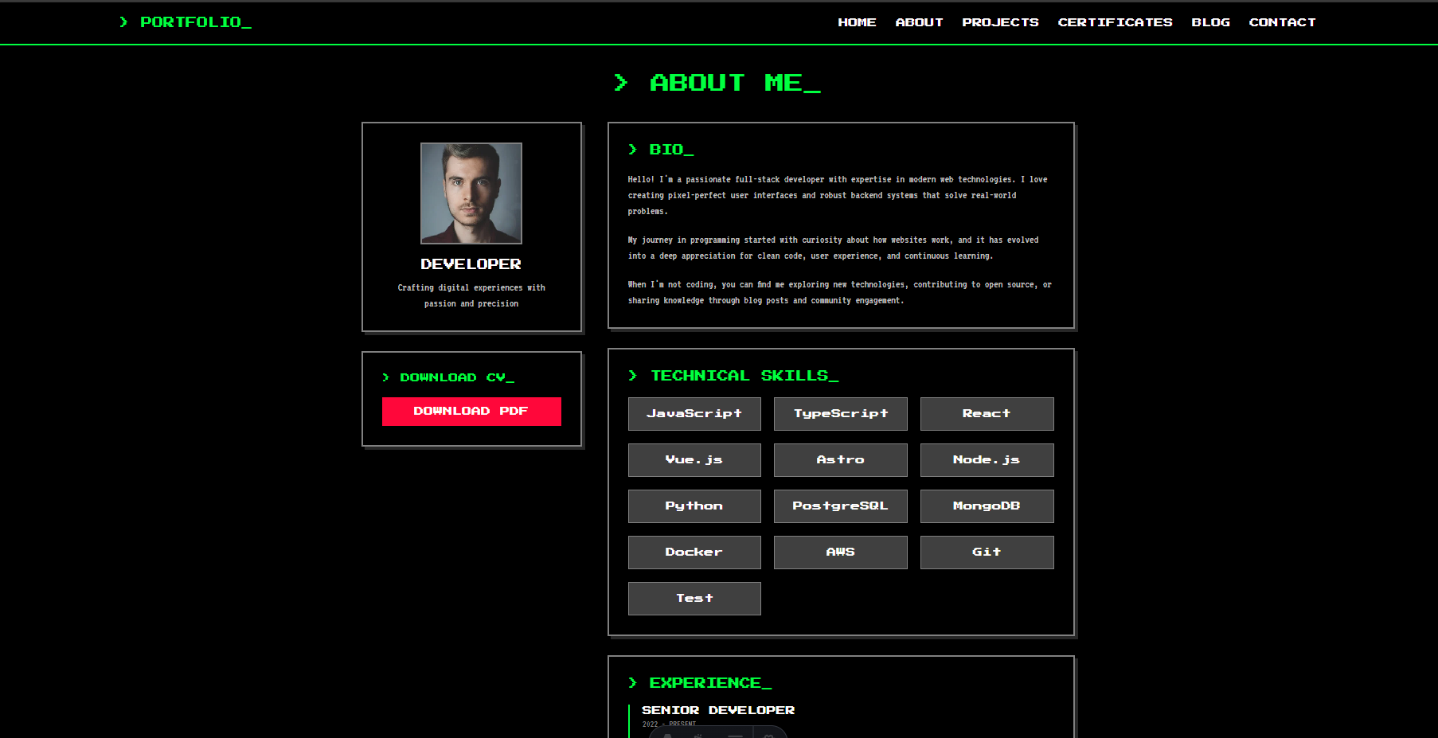
Demo
nvhai248/astro: Simple blog building by astro
Notes:
What It Means: Loop keeps all project-related content (notes, tasks, documents) in one place, reducing the need to switch between apps.
Why It Matters: This saves time and ensures nothing gets lost or overlooked.
Example: "Instead of searching through emails, Teams chats, and shared drives, everything we need is in the Loop workspace."

Slide 29
07
Q&A

